Slide 1

D212 Data Mining II Performance Assessment: Task 3 Market Basket Analysis
Jill Rivera, Student
Masters of Science: Data Analytics
Western Governors University
Notes:
Hello and welcome. My name is Jill Rivera, and I am a student in the Master of Science in Data Analytics program at Western Governors University. Today I will be presenting the performance assessment for D212 Data Mining II, Task 3. This will be a market basket analysis on consumer products.

Slide 2
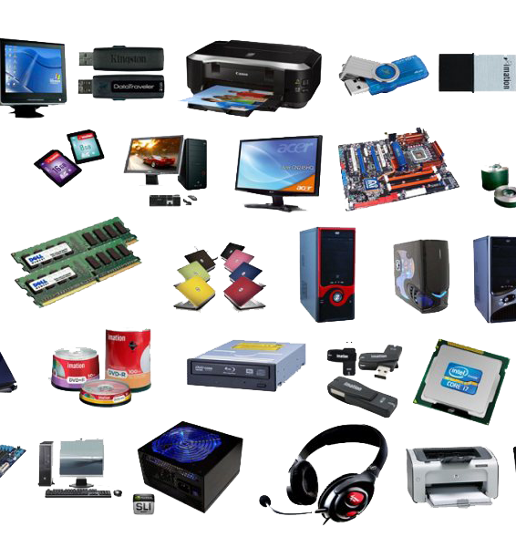
Agenda
Research Question
Market Basket Analysis
Example
Assumption
Data Preparation and Analysis
Data Cleaning
Apriori Algorithm
Top 3 Rules
Data Summary and Implications
Association Rule Significance
Practical Significance
Recommendations
This Photo by Unknown Author is licensed under CC BY-NC
Notes:
For this presentation, I will first discuss the research question that will be answered by this analysis. I will then discuss the market basket analysis method, give an example of a transaction to be analyzed, and go over assumptions of the method. I will then show how the data was cleaned to run the apriori algorithm and find the top three rules of the analysis. Finally, I will discuss the significance of the association rule as well as the practical significance and recommendations derived from the analysis.

Slide 3

Research Question
What group of products are the customers most likely to purchase?
This Photo by Unknown Author is licensed under CC BY-NC
Notes:
A telecommunications company is attempting to understand their customer base in a more detailed manner. The company has a data set containing customer transactions for products that they offer to customers and would like to figure out which products the customers’ favor. A market basket analysis on the data set will be conducted to produce this information. The analysis will answer the question of: What group of products are the customers most likely to purchase? The goal of this analysis is to find a group of products that the customers want to buy. This is a great way to evaluate the products the company offers and determine their value for the business.

Slide 4
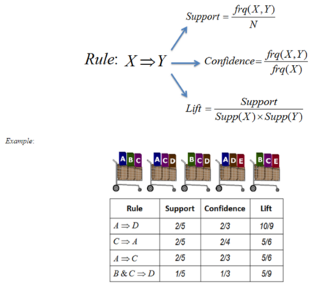
Market Basket Analysis
Notes:
In data analysis, finding patterns in data is common theme. Pattern detection can enable the evaluator to see trends in the data and give recommendations for changing or strengthening that pattern. This analysis will use the market basket analysis method to predict patterns in the telecommunication component data gathered.
This analysis method searches for product combinations that are frequently purchased together. This method benefits from using larger data sets so that more transactions can be compared and produce more accurate results. Market basket analysis uses association rules to calculate the relationship between products. The product is a rule, which consists of an antecedent and a consequent. These are just lists of items that are purchased by a customer, with the antecedent occurring first and the consequent being a co-occurrence in the transactions. An itemset or set of items in the antecedent and consequent, is produced for every rule. The components of the association rule are calculated to analyze the itemset. Those components are support, confidence, and lift. Support is how often the itemset appears in the data. Support is calculated by dividing the number of transactions with the itemset by the total number of transactions. Confidence calculates if the itemset is popular with individual or combined sales. Confidence is calculated by dividing the combined transactions by the individual transactions. Lift is the ratio between confidence and support and tells the likelihood of both items being bought together. (Li, 2017) A diagram of how the association rules of market basket analysis is shown to visualize these calculations.

Slide 5
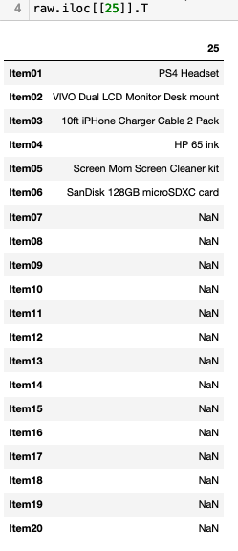
Example Transaction & Assumption
Notes:
Using the iloc function in Python, an example transaction is displayed. This is transaction number 25 in the data set, and you can see that the customer purchased six items. The remaining item slots are listed as NaN since they are empty.
The biggest assumption of market basket analysis is that there will be overlap of items in the transactions. If the data set were to consist of transactions with no overlap of items, this analysis technique would not produce any results. There must be multiple transactions with the same group of products to calculate the association rules.

Slide 6
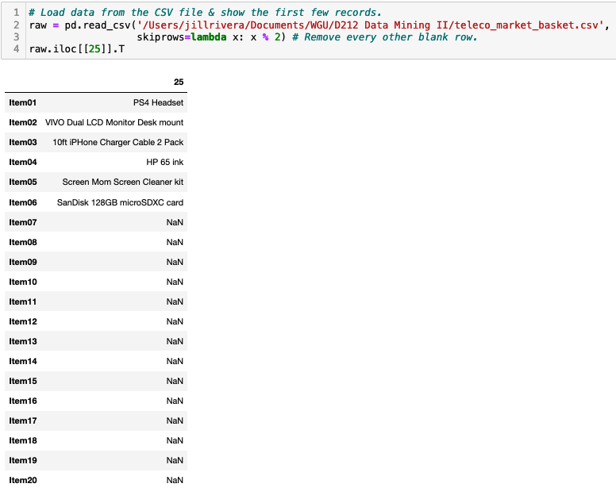
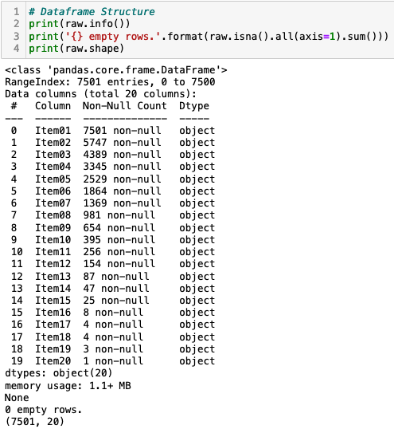
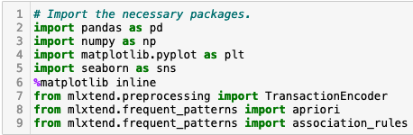
Data Preparation
Notes:
The market basket analysis is performed in a Jupyter Notebook using the Python 3 programming language. The data set is manipulated and cleaned prior to performing the market basket analysis. First, the libraries needed are imported.
Using Pandas, the CSV file is read and the iloc function shows an example transaction.
The data set is evaluated using the info, format, and shape commands. This data set consists of 7501 rows of data and 20 data attributes.

Slide 7
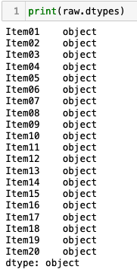
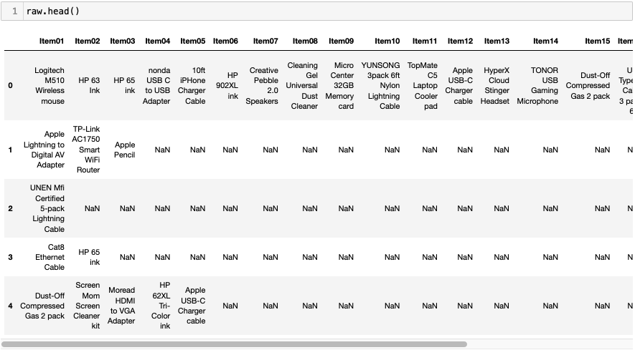
Data Preparation
Notes:
The head command shows the first five rows of the data set.
Using the dtypes command, all attributes are shown to be object in type.

Slide 8
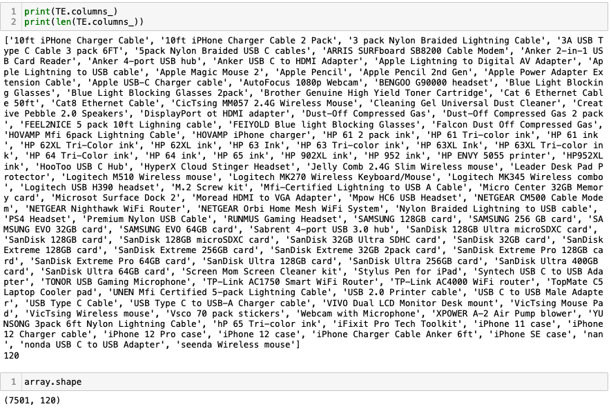
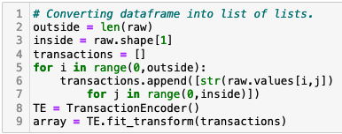
Data Preparation
Notes:
To perform the analysis, the data needs to be set up in lists so that each transaction shows all the items purchased on the same row. A simple loop is created to accomplish this.
There are now 120 columns or transactions in the data frame, and using the columns command they are listed.

Slide 9
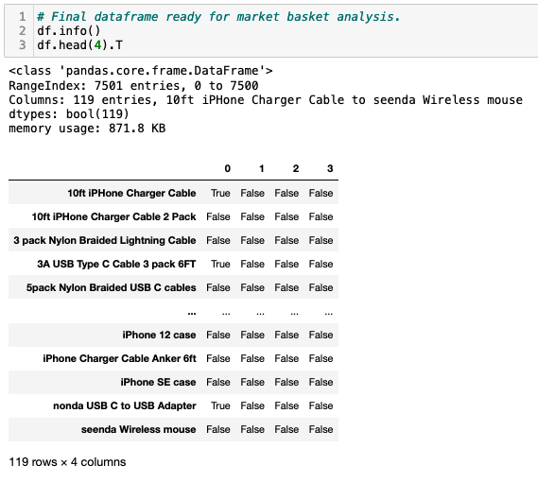
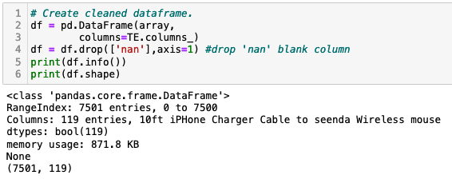

Data Preparation
Notes:
Now, the null values can be dropped using the drop command to create the final clean data set of 7501 rows and 119 columns.
The info and head commands show the cleaned data frame’s first four columns.
This data frame is exported into a CSV file labeled “D212Task3Clean.CSV” using Pandas and is attached to this submission.

Slide 10
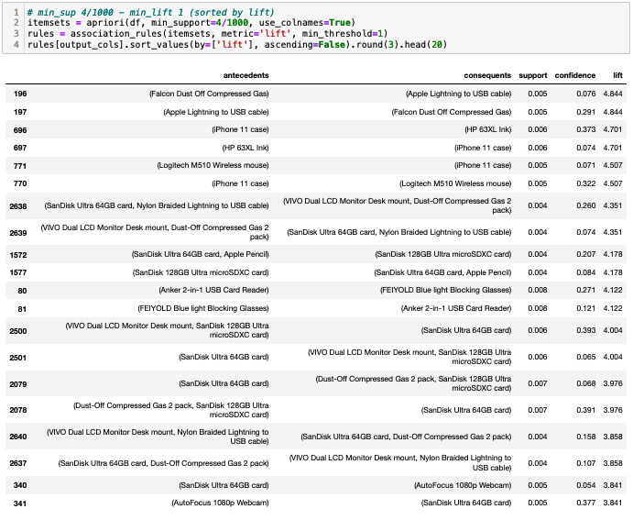

Data Analysis: Apriori Algorithm
Notes:
To perform the analysis, first the outputs of antecedents, consequents, support, confidence, and lift are defined.
Using MLXtends frequent_patterns (Raschka, 2022) package, the itemsets and rules are identified using the minimum support of 4/1000 and sorted by lift.

Slide 11
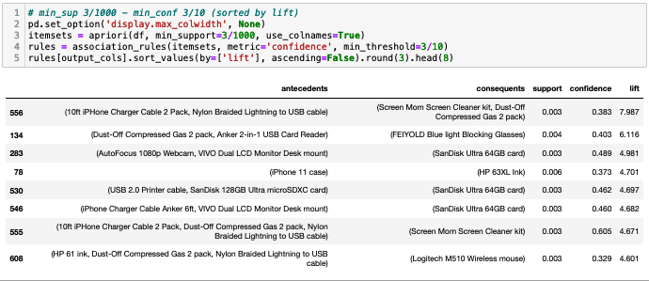
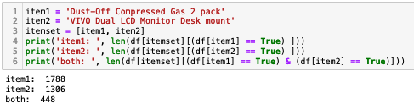
Data Analysis: Apriori Algorithm
Notes:
This process is re-run using the parameters of 3/1000 for the minimum support and the minimum confidence of 3/10.
In reviewing the results, the items of “Dust-off Compressed Gas 2 Pack” and “VIVO Dual LCD Monitor Desk Mount” are identified the most, so these items are defined. Running the itemset on these two items shows that they are bought together 448 times in this data frame.

Slide 12
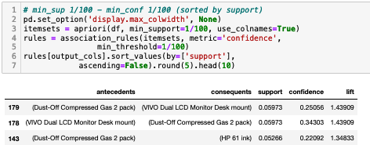
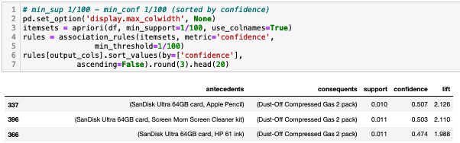
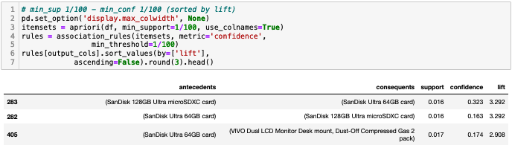
Data Analysis: Association Rules
Notes:
Running the Apriori algorithm again with the minimum support and confidence of 1/100 and sorted by support is run. It shows that there is a support value of 0.06 in this data set, which is a very low score.
These same parameters are run again but are sorted by confidence score. It shows a confidence score of 0.51, which is a mid-range value since the range is between 0 and 1.
The algorithm is run again and sorted by lift score. This shows a stronger lift value of 3.29 with the combination of the 128GB SanDisk card and the 64GB SanDisk card.

Slide 13

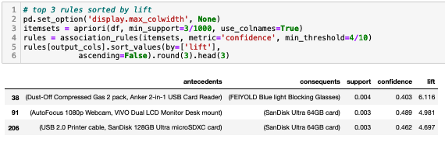
Data Analysis: Top 3 Rules
Notes:
To identify the top three rules for the analysis, first the data is pruned to count the number of times the itemset occurs in the data frame to weed out infrequent itemsets. There are now 432 rules to analyze.
Running the analysis and sorting for lift, the top three rules are summarized. The best rule produced has a lift value of 6.116, which is a strong indication that the itemset would be purchased together. This itemset includes the “Dust-Off Compressed Gas 2 pack”, “Ankler 2-in-1 USB Card Reader”, and “FEIYOLD Blue light Blocking Glasses.”

Slide 14
Data Summary and Implications
Association Rule Significance
Support: 0.4%
Confidence: 40.3%
Lift: 6.116
Practical Significance: Limited Data Set
Recommendations: Product Placement of Items
Notes:
The final market basket analysis, rule significance, and recommendations are discussed.
The top rule that the analysis produced is shown in the figure. From this, the support for this rule is a value of 0.004 can be derived. This is calculated by dividing the number of transactions with “Dust-Off Compressed Gas 2 pack”, “Ankler 2-in-1 USB Card Reader”, and “FEIYOLD Blue light Blocking Glasses” by the total number of transactions.
The confidence value of this itemset is calculated at 0.403, which equates to 40.3 percent of the transactions that had “Dust-Off Compressed Gas 2 pack” and “Ankler 2-in-1 USB Card Reader” as the antecedent also had the “FEIYOLD Blue light Blocking Glasses” as the consequent.
The lift value of this rule is strong with a score of 6.116. This states that a customer is six times more likely to purchase the “FEIYOLD Blue light Blocking Glasses” if they are also buying the “Dust-Off Compressed Gas 2 pack” and “Ankler 2-in-1 USB Card Reader” together.
Market basket analysis is typically performed on very large data sets; however, this data set was only 7501 transactions. This made the calculations limited and caused a low support value to be calculated for even the top rules. Since the confidence level was calculated at 40.3 percent for the top rule, the rule should still be considered a good itemset combination and strong association.
The product placement for “FEIYOLD Blue light Blocking Glasses” should be next to the computer accessories. Specifically, the blue light glasses should be placed next to the “Dust-Off Compressed Gas 2 pack” and “Ankler 2-in-1 USB Card Reader.” That same display should be next to the selection of memory cards. This will increase the likelihood of these items being purchased together and increasing sales. This will also improve customer service for the ease of finding what they need in the store.

Slide 15

Questions
Notes:
Any questions

